Slide 1
Title here
EUROPLANET 2015

Slide 2
Europlanet links laboratories active in planetary research in Europe and around the world.
www.europlanet-eu.org
In recent years, Europe's planetary space science programme has received wide-spread recognition
for a string of successful missions. Mars Express, the first purely European mission to another planet, was an outstanding success. The dramatic landing of the European Huygens probe on Titan in January 2005 and the on-going success of the joint ESA/NASA Cassini-Huygens Mission to Saturn show Europe's capability and innovation in planetary science technology.

Slide 3
Europlanet links laboratories active in planetary research in Europe and around the world.
www.europlanet-eu.org
In recent years, Europe's planetary space science programme has received wide-spread recognition
for a string of successful missions. Mars Express, the first purely European mission to another planet, was an outstanding success. The dramatic landing of the European Huygens probe on Titan in January 2005 and the on-going success of the joint ESA/NASA Cassini-Huygens Mission to Saturn show Europe's capability and innovation in planetary science technology.

Slide 4
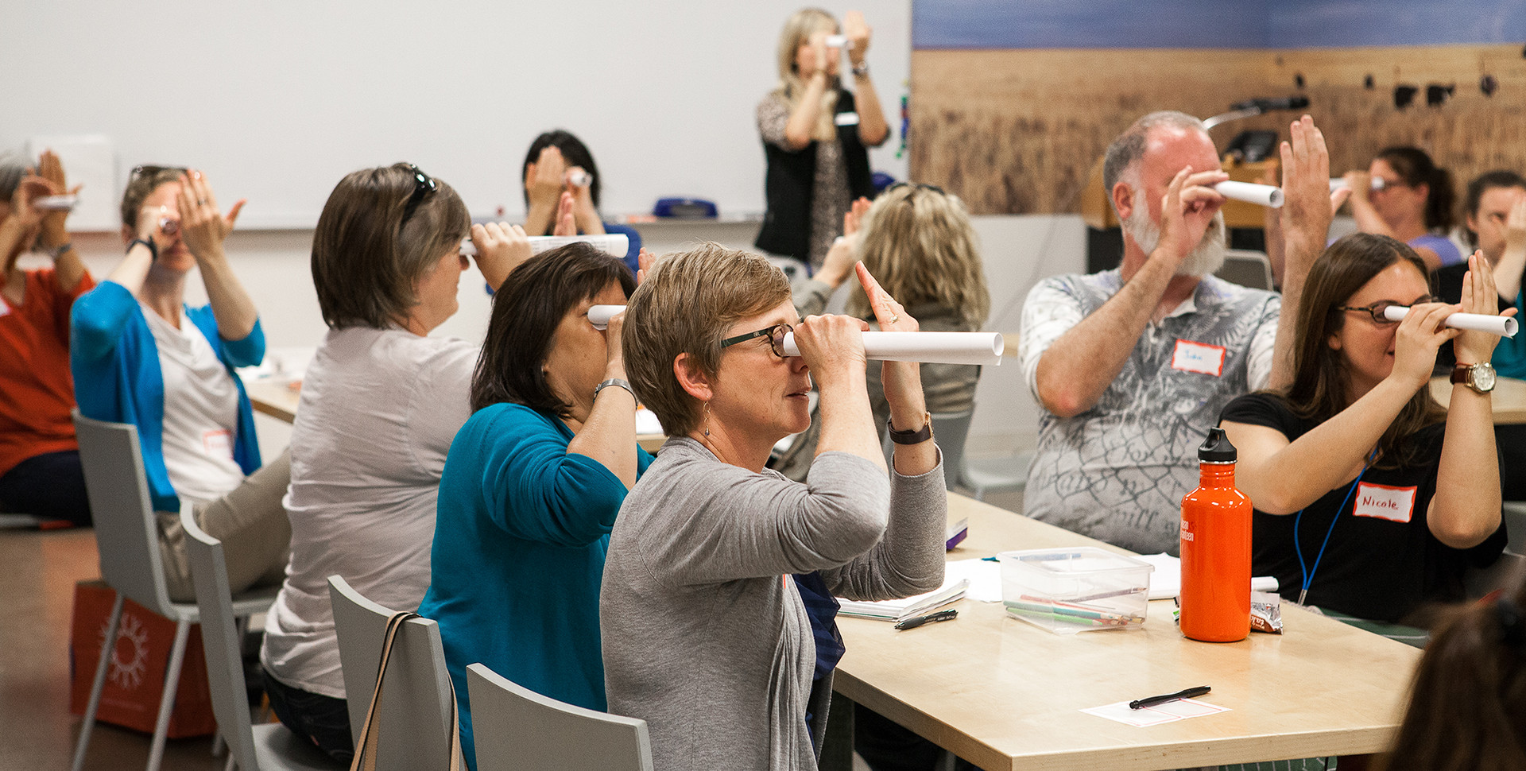
www.europlanet-eu.org
Image from esa (www.esa.int)

