Slide 1
Peer-support networks The key to building great researcher communities?
EPEC: The Europlanet Early Career Network
EGU 2019 SC3.21 Maike Brigitte Neuland – Europlanet Early Career Network

Slide 2
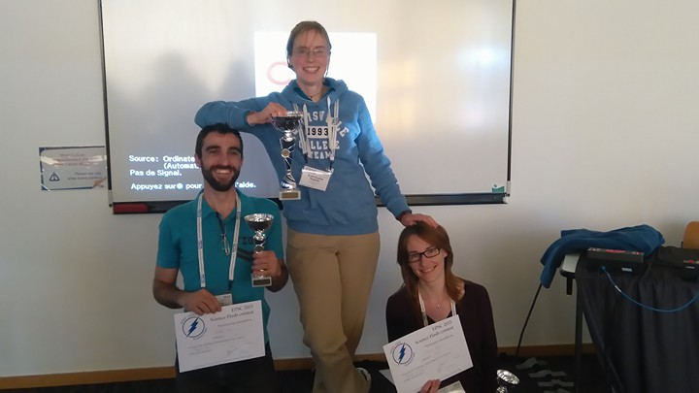
Short History
2014: EGU PS ECS Representative: Lena Noack Our idea Provide an attractive program for early career scientists (short courses etc) at the European Planetary Science Congress (EPSC)
in the name of EGU ECS
EPSC 2014 in Cascais/Portugal
► 3 short courses and a science flash
► A new part of the EPSC program was established ☺
similar ECS program at EPSC 2015 in Nantes

Slide 3
A community to foster planetary sciences (meetings, access to research facilities, …)
Definition of a road map Planning ahead → involving young scientists
Change from community to society
Europlanet approached us (in 2016) to form a network of young researchers within the society
Finding the initial members
to start the network
A lot of… …web-search … email-writing
…asking around

Slide 4
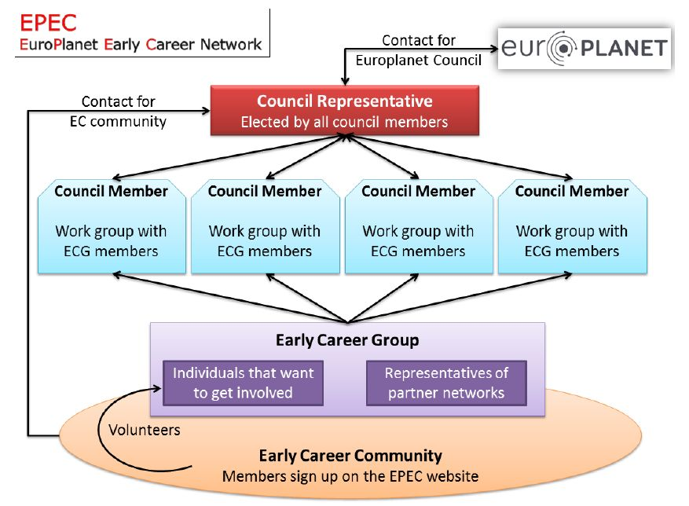
Thinking of the network’s purpose and structure

Slide 5
Official launch of
at the EPSC 2017 in Riga
Action item No.1 Attract more members!!!!!
Advice No.1 Do not let people sign up to email-lists by handwriting

Slide 6
The EPEC network consists today of 7 working groups:
→ EPEC Annual week
→ EPEC Annual week
→ EPSC activities
→ EPSC activities
→ Future space research
→ Connected to Europlanet Roadmap
→ Future space research
→ Early career support
→ Early career support
→ outreach
→ outreach
→ diversity
→ diversity
→ communication
→ communication
EPEC members and early career scientists interested in EPEC meet once per year for 5 days
Participation via application (for non-committee members)
Europlanet provides accommodation and 150€ travel support
Intense workshops and trainings, working groups work

Slide 7
What a «network»?
defines needs
monthly newsletter
common interest/field/dream/aim
leader/president/representative
regular meeting
in person
online
?
deliverables
organisational structure, purpose & rules
?
balance of giving and getting help and support
?
funding
senior/well known scientists

