Slide 1
Brines on Mars
Understanding Saturated Salt Solutions

Slide 2
Objectives
By the end of this lesson you will be able to:
Understand how crystallisation works.
Understanding saturation points.
Understand how do saturated salt solutions affect habitability.

Slide 3
Introduction to Saturation
What is solubility and a saturation point?
Solubility = the maximum amount of a solute that can dissolve in a solvent at a specified temperature and pressure.
It is measured in terms of the maximum amount of solute dissolved in a solvent at equilibrium.
The resulting solution is called a saturated solution.

Slide 4
Super-Saturation
Notes:
•Thick atmosphere keeping in heat
•Large oceans at high temperatures.
•Atmosphere became thinner through this era and water cooled, but would this water be habitable?

Slide 5
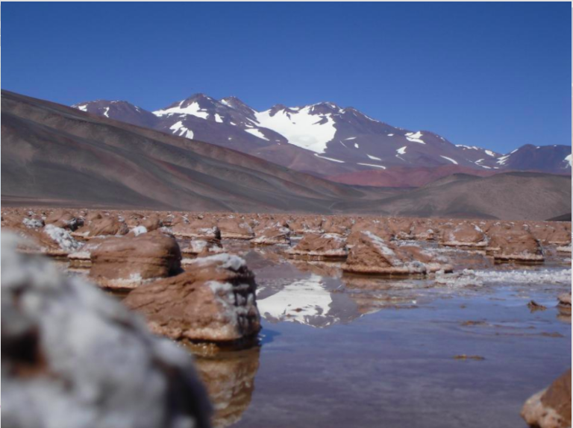
Laguna Negra Argentina
In the Argentinian Andes.
Can be used as an analogue to past Mars due to high concentrations of CaCl₂ salts.
Image source: Fernando J. Gomez

Slide 6
How habitable do you think the Laguna Negra is?
Image source: Fernando J Gomez

Slide 7
Crystallisation

Slide 8
What does crystallisation look like?
Click button below to link to video:

Slide 9
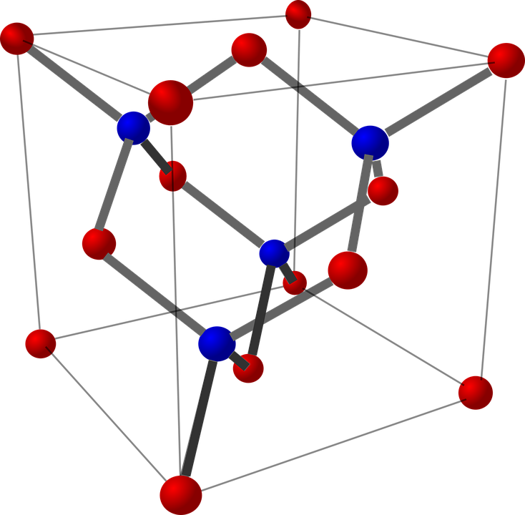
What happened? Why?
Discuss in groups
Notes:
•Lots of volcanism in Tharsis Region
•Planet warmed as volcanic eruptions poured ash and gases into the atmosphere.
•Clouds probably developed and precipitation rained to the ground, forming lakes in many basins and craters.

Slide 10
Recap
1
2
3
Understand how crystallisation works.
Explain how we get saturated and super-saturated solutions.
Reason how saturated salt solutions affect habitability.
Now we can...

