Slide 1
Europa
Icy Moon of Jupiter
Notes:
In this lesson, we will be focusing on Jupiter’s moon Europa, the ocean that lies beneath its icy surface and its potential as a habitat for life.

Slide 2
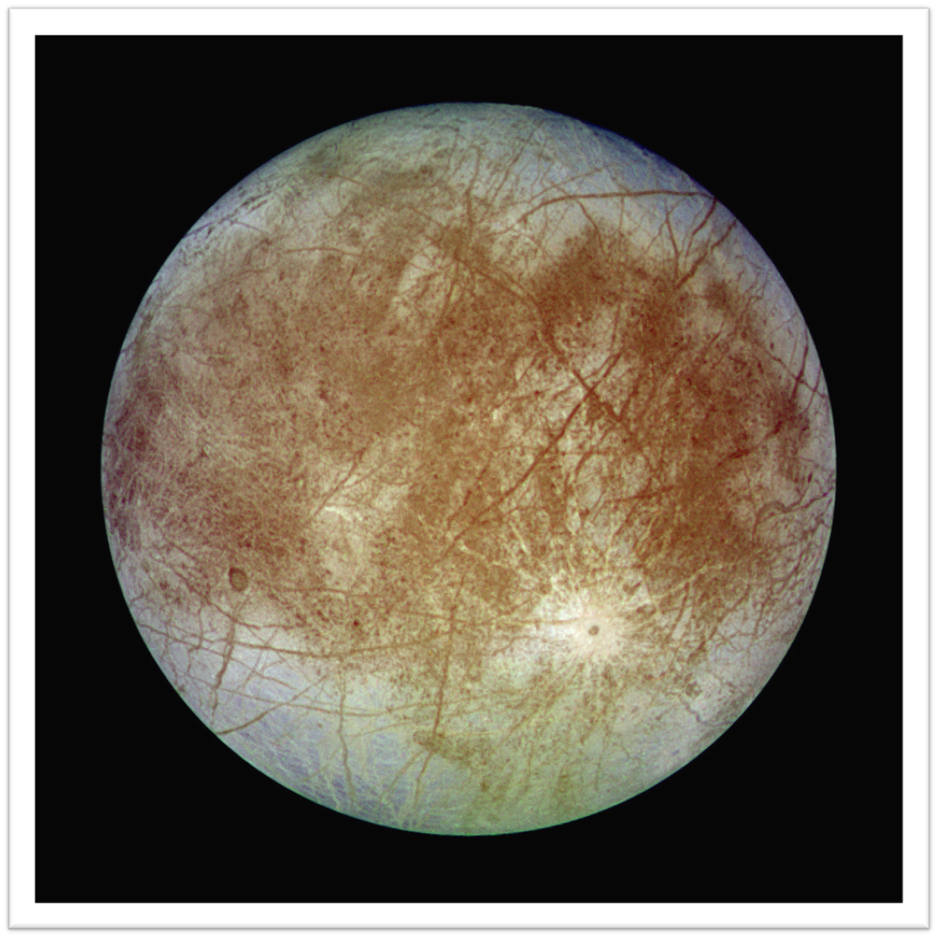
Objectives
By the end of this lesson you will be able to:
Understand the composition of Europa
Explain the formation of the cracks on Europa’s surface
Describe the nature of Europa's subsurface oceans
Explore extremophiles and life in space

Slide 3
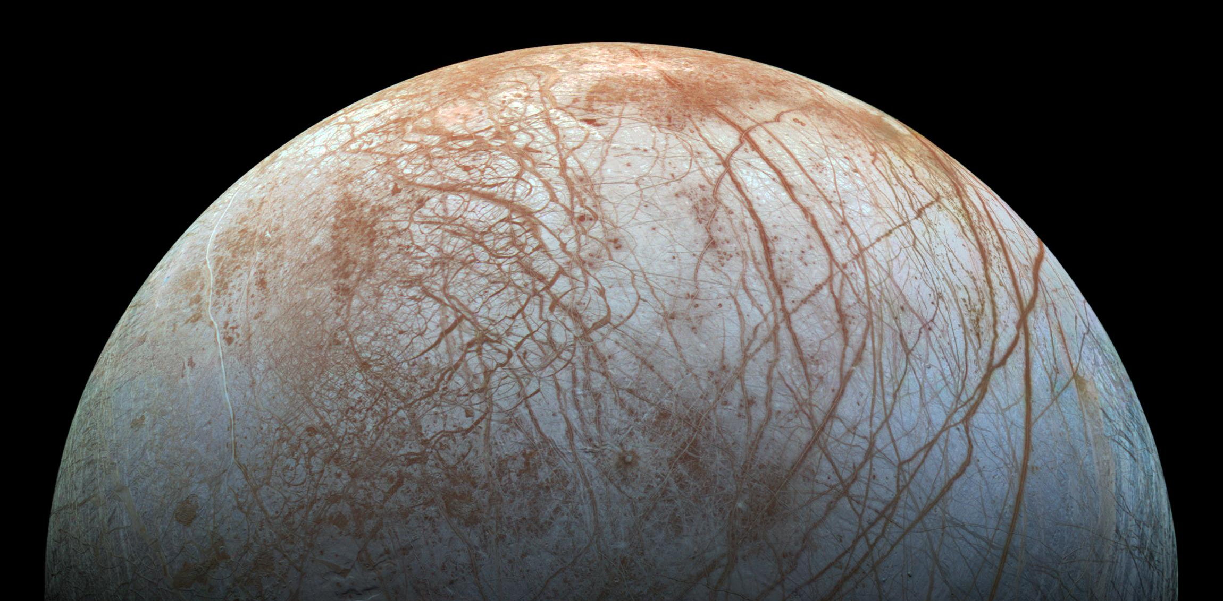
Europa captured by the Galileo mission
(NASA/JPL-Caltech/Seti Institute, late 1990s)
Notes:
Jupiter has at least 92 moons, some of which have diameters of less than 1 kilometre. Europa is the smallest of the four largest moons of Jupiter, known as the Galilean moons because they were discovered by Galileo Galilei in 1610. You see the four Galilean moons if you look through binoculars or a small telescope.
Europa is the sixth largest moon in our Solar System, and is about the same size as Earth’s Moon. It has the smoothest known surface of any moon, with very few craters. In fact, Europa has the smoothest surface of any known object in our Solar System.

Slide 4
Geology of Europa
Notes:
Because, to date, we have limited data about Europa gathered by space missions, there are still many things we don’t know about this moon of Jupiter. The European Space Agency (ESA) mission, the Jupiter Icy Moons Explorer (JUICE), and NASA’s Europa Clipper mission will help change that. JUICE, which launched in April 2023, will arrive at Jupiter in 2031 and will make two flybys of Europa before going into orbit around Ganymede. Europa Clipper, which will launch in 2024 and reach Jupiter in 2030, will make over 50 flybys of Europa.
The internal structure of Europa is thought to be a metallic core, surrounded by silicate rock, which together account for the majority of the moon’s mass. This is covered by a global, liquid water ocean, beneath a thick icy crust. The temperatures on Europa are extremely cold (- 220 Celsius to – 160 Celsius).

Slide 5
Europa’s surface
Notes:
Despite its unusual smoothness, the surface ice of Europa is marked with long, thin, parallel streaks or stripes. These stripes are actually cracks, referred to as lineae. The lineae are caused by tidal heating. Europa’s orbit of Jupiter is not perfectly circular, so there are times when the two bodies are closer or further away from each other. In the same way as the gravitational pull of the Moon causes Earth’s oceans to bulge out on either side, the intensity of Jupiter’s gravitational pull on Europa stretches and compresses the entire moon at different points during its orbit. This deformation cracks the icy crust, forming the lineae.

Slide 6
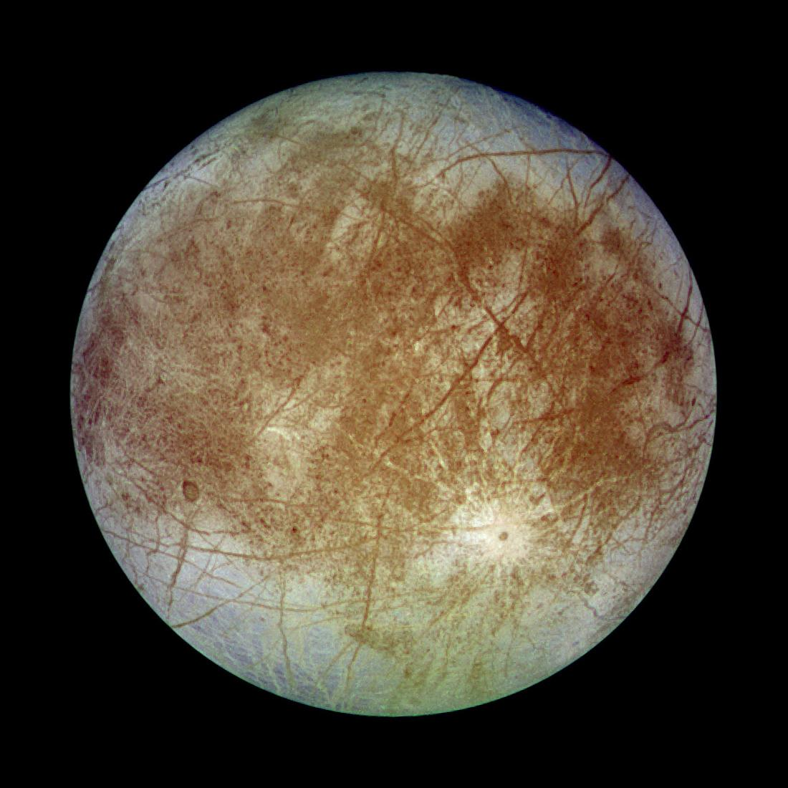
Notes:
Material from the ocean below and within the icy crust can seep out through the lineae to the moon’s surface. This is important because it indicates that there is transfer of material between the ocean and the crust. Therefore, although space missions to date (including JUICE and Europa Clipper) can’t access the ocean directly, analysis of the material seeping through the lineae can give us a very good indication of the ocean’s composition and density.

Slide 7
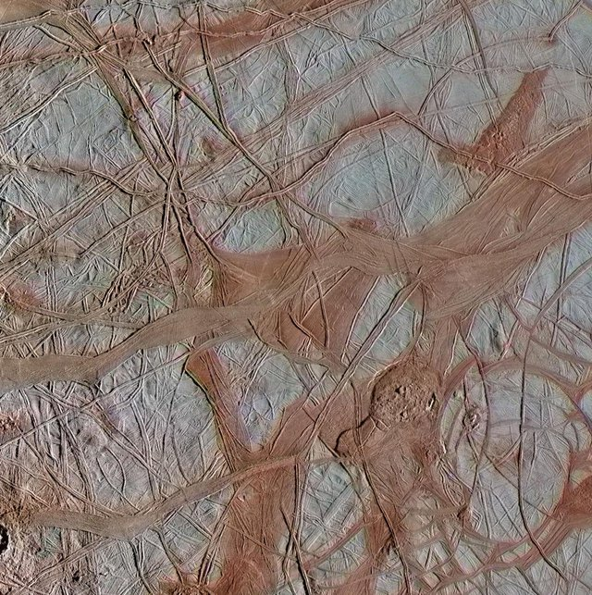
Europa's Chaos Terrain
NASA, 2020
Notes:
Regions of Europa’s surface that are particularly cracked are known as ‘chaos terrain’. These areas are particularly interesting for studying material that has seeped through from the sub-surface ocean. The blue-white terrains indicate relatively pure water ice, whereas the reddish areas contain water ice mixed with hydrated salts, potentially magnesium sulphate or sulfuric acid. Jupiter’s huge magnetic field traps high energy particles, creating powerful radiation that constantly bombards the surface of Europa. The interaction of high energy particles ‘weathers’ the moon’s surface by driving chemical reactions and altering the physical properties of the ice, such as grain size.

Slide 8
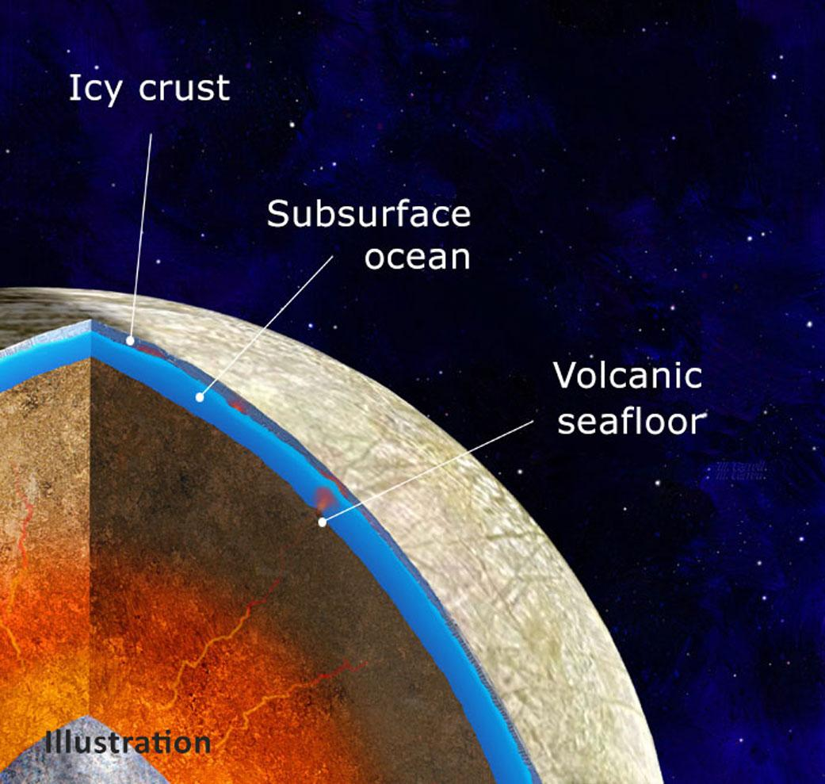
Europa’s Sub-surface ocean
Notes:
Europa is unique and interesting as a moon. Past missions have shown that Europa has a magnetic field that is generated by some kind of conductive fluid beneath the icy crust. Measurements of Europa’s magnetic field, the moon’s density (derived from its size and gravitational field), and analysis of the properties of its surface ice indicates that Europa has a subsurface ocean of salty water that is more acidic than terrestrial seawater. Although temperatures at Europa are very cold, an ocean of liquid water could be sustained because salt lowers the freezing point of water. The salty ocean is in contact with the rocky shell around Europa’s core. This is interesting to scientists as the interaction between salty water and rock in the ocean is similar to that suggested by the “primordial soup” concept for the emergence of life on Earth, whereby organic molecules were mixed in ancient bodies of water, assembling to form living organisms.

Slide 9
How salt lowers the freezing point of water
Notes:
https://youtu.be/BuAhcD90jww
Here we have two beakers both filled with coloured tap water. To the beaker on the right, we add ordinary table salt, sodium chloride. The sample on the left is just water with food colouring. Next we add dry ice, solid carbon dioxide, to cool the two solutions. Carbon dioxide is solid at any temperature below minus 80 degrees Celsius. Now, we will compare the two samples. The sample on the left, with the salt, has formed a thick slush. The sample on the right without the salt has frozen completely solid.
When the salt dissolves in the water, it breaks into sodium and chlorine ions. The ions diffuse throughout the water and block the water molecules from getting close enough together and in the right orientation to organise into the solid form (ice). However, the water gets colder and the temperature can drop below the freezing point of pure water. Thus, although the ocean at Europa is very cold, it can be sustained as a liquid because it is salty and, thus, the freezing point of water is lowered.

Slide 10
Life in extreme cold Temperatures: Extremophiles
Notes:
Extremophiles are organisms that can survive in extreme climates. Any organisms on Europa would probably need to be able to survive in extremely cold temperatures. However, hydrothermal vents in the ocean could also create microcosms that could support life, just like on Earth. Around vents, the temperatures could be significantly higher than in the surrounding ocean - these environments could be very hot! Thus, although the surface of Europa is very cold, within the moon's oceans it could be fairly temperate.

Slide 11
Do you think there could be life on Europa?
Notes:
In small groups, discuss whether you think there is life on Europa and if so what sort of adaptations and features would you expect it to have.
● Would life just be microorganisms, or could larger forms of life might have evolved?
● What kind of metabolic processes might they have?
Remember, we need to wait for JUICE and Europa Clipper to arrive at Jupiter to find out more about Europa, and may still need to send future missions to definitively answer the question of whether there is life beneath the icy surface. For now, there are no right or wrong answers!

Slide 12
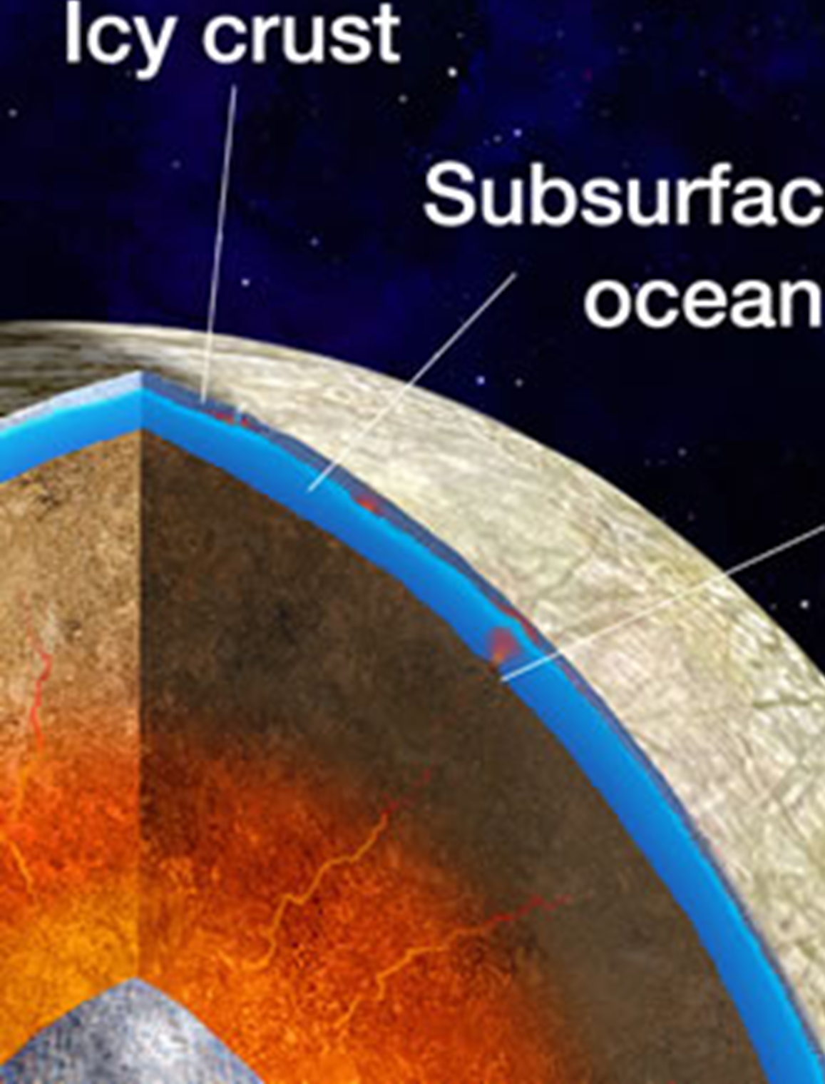
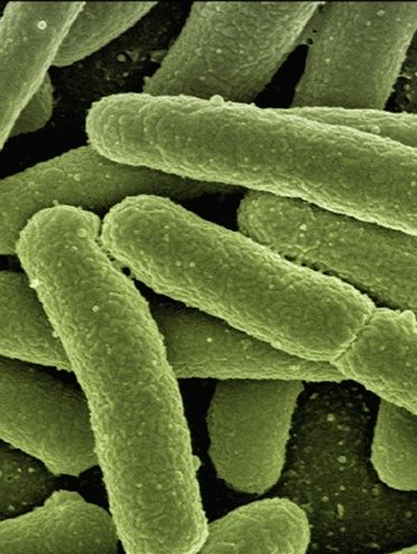
Recap
Now we can...
1
2
3
Describe the geology and composition of Europa
Understand interactions between the subsurface ocean and crust
Understand extremophiles and the potential for life on Europa
Notes:
From this lesson, students should be able to:
Describe the geology and composition of Europa.
Understand how material is exchanged between the subsurface ocean and the icy crust through cracks (lineae) caused by tidal deformation.
Understand extremophiles and the potential for life on Europa.

